Slide 1
Language Trends in Queer Communities
By: Q Leedham

Slide 2
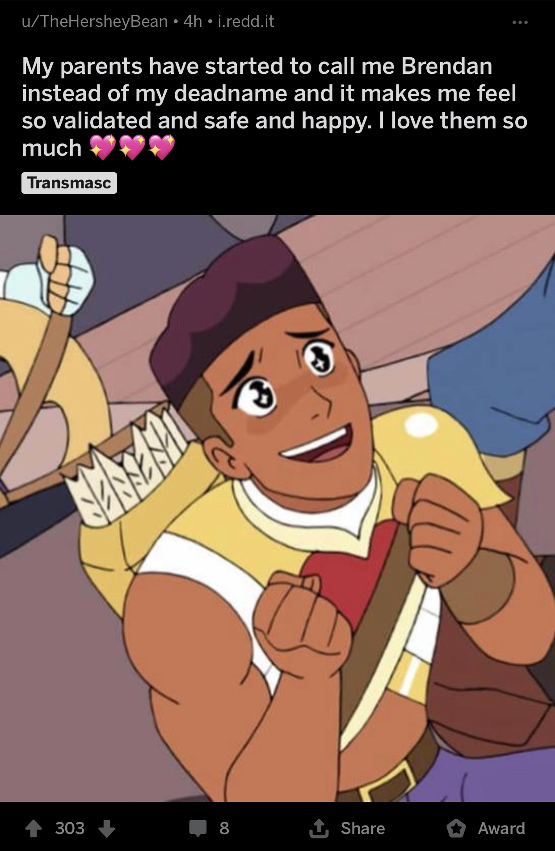
r/traaaaaaannnnnnnnnns
Subreddit by and for trans people
Full of memes
Occasionally serious

Slide 3
Most Frequent Words
Mostly community focused
“says trans rights” meme
Occasional post about dysphoria

Slide 4
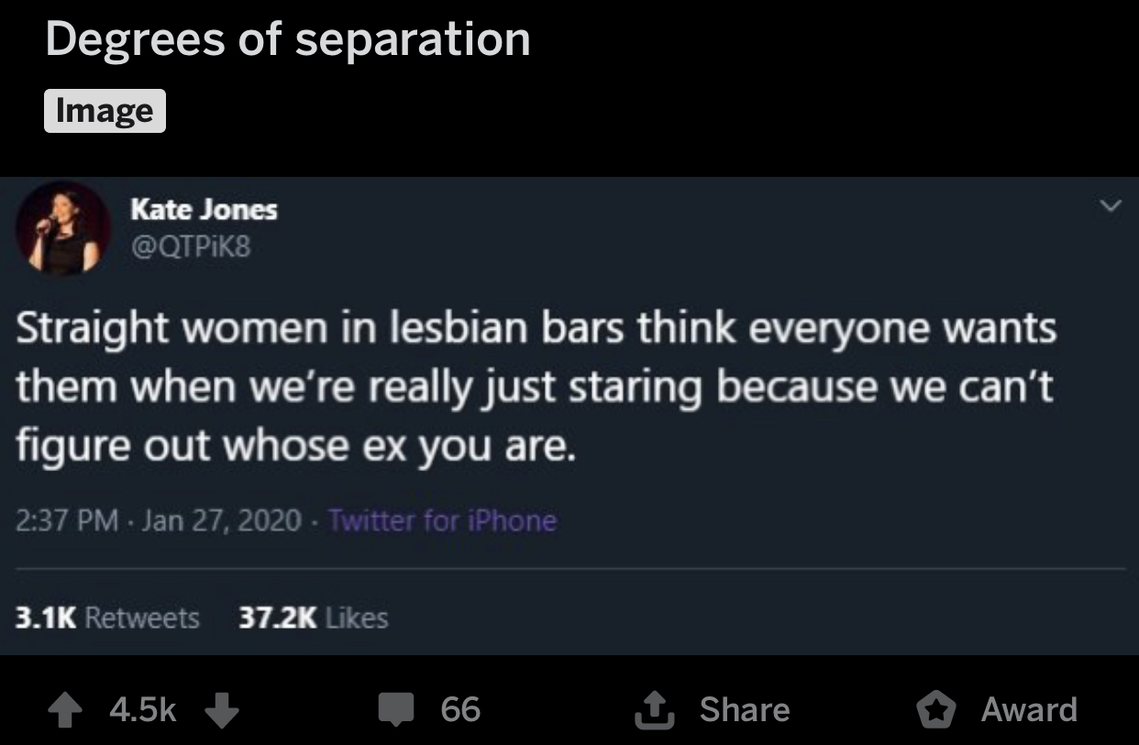
r/actuallesbians
For and by anyone who considers themselves a queer woman
Some memes
Occasional serious discussion

Slide 5
Most Frequent Words
More individual-focused
A lot of talk about love and girlfriends
Sometimes asking for advice

Slide 6
The Model
77% accuracy
TPR: 78.1%
(trans)
TNR: 76.8%
(lesbian)

Slide 7
Coefficients
Top coefficients are well above zero
Bottom are very close to zero
Mostly r/traaaaaaannnnnnnnnns at the top

Slide 8
Recommendations
Examine groups that overlap less
Look at how the communities talk to others outside the community

